Slide 1
Branching Strategies:
Introduction to branching strategies
February 2021

Slide 2

What is a Branch?
Essentially, a branch is a pointer to a snapshot of your changes

Slide 3
Why Branch?
Easy to use
Try new ideas
Isolate features
Protect our main branch from unstable code

Slide 4
What is a Branching Strategy?
A Branching strategy defines:
How many branches you have
The longevity of your branches
When and where you make commits, pull requests, and deployments
When you should create a new branch
Development pipelines
How to handle commit history

Slide 5

Branching Strategy goals
Implement a strategy that will let developers develop
Organize the chaos
Isolate the next release from the current version being used
Introduce hotfixes to the current version
Easy to undo mistakes and errors
Avoid unnecessary overhead
Identify and address key requirements
Lay the foundation for future CI/CD efforts
Notes:
Branching Chaos adds overhead

Slide 6
Workflow Examples
Basic Workflow
Feature-Branch Workflow
Forking Workflow
Trunk-Based
GitFlow
Github Flow
GitLab Flow
Current OneStream Workflows
Custom workflow

Slide 7
Basic Workflow
Provides very limited options
Good starting point for those new to Git
Single central repo
Simple to track changes on mutually exclusive set of files
Each developer clones from this repo
All local changes are pushed back to central repo
Other team members pull these updates to update their local repo
Developers work on local versions of the code base
Best for small projects that do not change often

Slide 8
Feature-Branch Workflow
Logical advancement from Basic workflow
Likely the building block to another workflow
Best used for large teams and projects
Feature development takes place in a dedicated branch
Projects require different developers to work on different features for the same project
Each feature may touch many common files
Each Feature has its own independent timeline
Feature 1 to be released should not impact Feature 2 readiness
Developers assigned to the feature work within the allocated branch
Once feature is completed, this branch is merged back into the main branch, to be released into production
Once completed, the feature branch is deleted

Slide 9
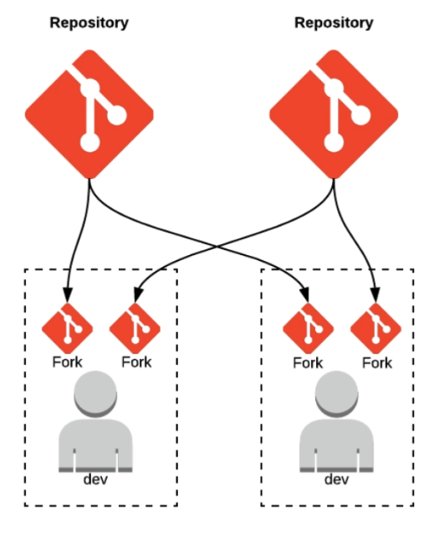
Forking Workflow
Forking is similar to Feature Branching
Based on the process of forking an entire Repo
Most commonly used with open-source projects
Developer makes changes to their own fork of the repo
PROCESS:
When the developer completes the changes within their own forked copy, they raise a Pull Request to merge the changes into main. The owner of the repo can accept or deny the Pull Request

Slide 10
Forking Workflow
Advantages
Disadvantages
Keeps branches separated
Reduces clutter in central repo
Works best in an external contributor scenario
Cannot push directly to main branch
Very hard to keep in sync with the central repo
Cannot view all works in progress
Difficult to collaborate
Fork owner needs to add person as a contributor
Team does not know what changed until the branch is merged
Notes:
Team does not know what changed until the branch is merged
Collaboration – Fork owner needs to add person as a contributor

Slide 11
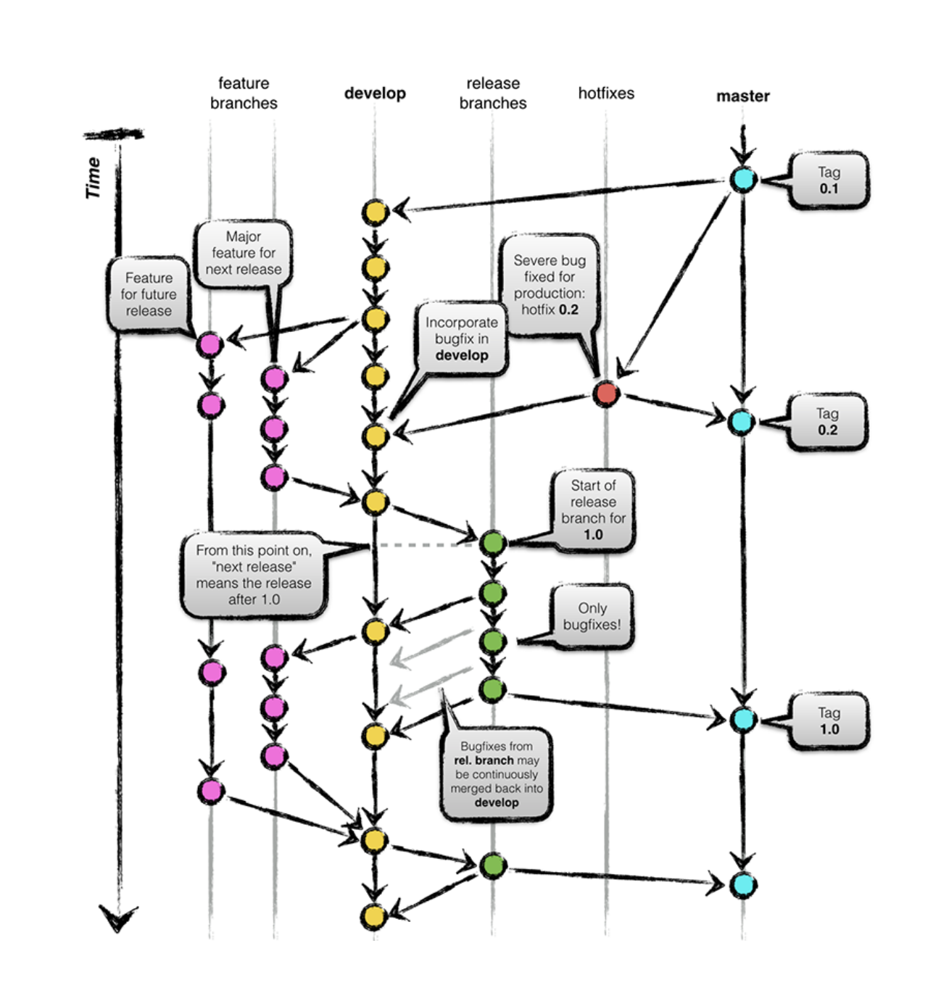
Gitflow
Builds upon the feature-branch workflow
Utilizes 2 parallel and long running branches; Main and Develop
All supporting branches are short-lived
The most complex workflow model
Great for large software projects
3 Supporting Branches are used
Feature – New Features for the upcoming release
Hotfix – Immediately act upon an undesired status of main
Release – Support the preparation of new production releases
Notes:
This is one of the first major branching strategies that gained popularity
created in 2010
describes multiple branches for development, releases and the orchestration between them
main branch is always production ready
Developers create feature branches from the develop branch. Once they are done, the complete a Pull Request. The Pull Request starts the discussion. Other developers can comment on changes, ask questions, and have discussions on the changes. Once agreed upon, the pull request is accepted and merged into the develop branch.
Once it is decided the develop branch has reached maturity for release, a new release branch is created. At this point Continuous Integration begins. Testing should uncover any bug and patches applied to this release branch.
After testing has concluded, the release branch is merged into the main branch and tag it with the release version.
While all of this is occurring, new features can be developed off of and on to the develop branch

Slide 12
GitFlow
Develop branch is created from main
Release branch is created from develop
Feature branches are created from develop
When a feature is completed it is merged into the develop branch
When the release branch is completed it is merged into develop and main branches
If an issue in main is detected, a hotfix branch is created from main
Once the hotfix is completed it is merged into develop and main

Slide 13
Gitflow
Advantages
Used by a lot of distributed, open-source teams that have varying skill levels. The project maintainers can review and approve every line of code going into releases
Works well for a traditional release model, where releases are done in terms of months and weeks
Works well when dealing with an established product or multiple versions in production
Ensures a clean state of branches at any given moment in the life cycle of project
The branches naming follows a systematic pattern making it easier to comprehend
It has extensions and support on most used git tools
Provides close review of code
Only authorized developers can approve changes
Ensures code quality and eliminates bugs early

Slide 14
Gitflow
Disadvantages
Can slow things down when having to look at large pull requests if you are trying to iterate quickly.
Releases are hard to do more than once a week
Starting off on the wrong branch can cause large scale issues with merging
Sacrifices simplicity for the sake of a comprehensive structure.
Pull requests could lead to extensive micromanagement
Larger features can spend days merging and resolving conflicts (merge hell) and force multiple testing cycles.
The Project history is full of merge commits and makes it hard to see the actual work.
Can be problematic in Continuous Integration or Continuous Delivery scenarios.
The Git history becomes unreadable
Release and hotfix branches require “double merging”
The main/develop split is considered redundant and makes the Continuous Delivery and the Continuous Integration harder
It isn’t recommended when a single version is maintained in production
Multiple branches and pull requests reduce development speed
Notes:
Double Merging – once to develop, once to main
Scripts help, but must be set up on every machine for every developer
scripts and extensions provided to help use/maintain Git Flow.

Slide 15
Trunk-Based
All developers work on a single branch
Immediate deployment after Production code is merged
Encourages feature flag use and automated testing
Short lived feature branches (1 person over a couple days)
Flows through PR style code-review and build automation before merging into main
Frequent rebasing is encouraged

Slide 16
Trunk-Based
Advantages
Disadvantages
Very simple
Minimizes merge conflicts
Smaller code review
Single long-lived branch
Allows you to iterate quickly and still maintain quality
Works well with in Continuous Integration or Continuous Delivery scenarios
Can release more often, including multiple times per day
Much tighter feedback loop for developers, business, and end-users
Works best with more experienced developers
Half finished features not properly implemented with feature flags can cause issues
Can cause some issues initially if there isn’t good test coverage or confidence in system stability
Little control over changes
Impossible to separate mature code from immature code
Does not work well with large teams. Merge conflicts will easily occur (merge hell)
Notes:
It offers maximum development speed with minimum formality. No Pull Requests mean developers can deliver new functionality very quickly.

Slide 17
GitHub Flow
Based on Gitflow, but simpler
Similar to Trunk-based workflow
Continuously deployable main branch
Feature branches created to work on features or bugs
Each feature branch must be completed and tested before being merged with main
A lightweight, branch-based workflow working off the main branch
After the work is ready, a pull request is generated and discussion with team, the branch is deployed to production

Slide 18
GitHub Flow
Follows 6 principles
Anything in main is deployable
To work on something new, create a branch off from main and give a descriptive name
Commit to that branch locally and regularly push your work to the origin branch
Using a pull request, discuss and review your code
After someone else has reviewed and signed off on the feature, it can be merged into main
Once it is merged and pushed to main, you can and should deploy immediately
Notes:
1.
The main branch is stable and it is always safe to deploy or create new branches
It's incredibly rare that a branch gets rewound - if there is an issue, commits will be reverted or new commits will be introduced that fixes the issue, but the branch itself is almost never rolled back.
2. Descriptive name
This has several advantages –
1 - When you fetch, you can see the topics that everyone else has been working on
2 - If you abandon a branch for a while and go back to it later, it's fairly easy to remember what it was.
It's almost like a list of upcoming features with current rough status.
'Compare' button to see what the actual unified diff and commit list is that is unique to that branch
3. Everything that is not main is simply something being worked on
4. Pull Requests are very important to the workflow process. This begins the discussion process. This is also your internal code review system

Slide 19
GitHub Flow
Advantages
Disadvantages
Can release often
A simpler alternative to Git Flow
It is ideal when it needs to maintain single version in production
Can work well for CI/CD
Only testing and automating changes to a single branch
Smaller teams can build, test, and deploy features fast
Testing in production
Can run into scaling issues as the team increases (merge hell)
It isn’t recommended when multiple versions in production are needed
Requires tighter controls around code review
Since all changes are merged to main, risk of production code becoming unstable
Fixing of Production code stops integrations
Issues are addressed on main branch
Notes:
It offers maximum development speed with minimum formality.
Before any other code can be integrated or worked on, developers need to spend time fixing any issues in the main branch
With GitHub, you can deploy from a branch for final testing in production before merging to main.
Once your pull request has been reviewed and the branch passes your tests, you can deploy your changes to verify them in production. If your branch causes issues, you can roll it back by deploying the existing main branch into production.
Different teams may have different deployment strategies. For some, it may be best to deploy to a specially provisioned testing environment. For others, deploying directly to production may be the better choice based on the other elements in their workflow.

Slide 20
Gitlab Flow
Based on 11 rules
Use feature branches, no direct commits on main
Test all commits, not only commits on main
Run all the tests on all commits
Perform code reviews before merges into main, not afterwards.
Deployments are automatic, based on branches or tags.
Tags are set by the user, not by CI.
Releases are based on tags.
Pushed commits are never rebased.
Everyone starts from main, and targets main.
Fix bugs in main first and release branches second.
Commit messages reflect intent.

Slide 21
Gitlab Flow
Notes:
An extension of GitHub Flow
adds environment and release branches
Excels for the use case where you have multiple different environments that you need to support
As code is merged from one branch to the other, it is generally deployed to specific environments
Teams can cherry pick bugs, features, and fixes to move from main into the next branch
It offers maximum development speed with minimum formality. No Pull Requests mean developers can deliver new functionality very quickly.

Slide 22
Gitlab Flow
Advantages
Disadvantages
The git history will be cleaner
Best option where multiple different environments are required (SaaS/Mobile)
Immature code is isolated
Cleaner history
No PR
It is more complex than the GitHub Flow
It can become very complex if multiple versions are maintained in production
Can be complex to implement CI/CD
Moving code through multiple staging areas can potentially delay its release
Working off main branch
No PR
Notes:
It offers maximum development speed with minimum formality. No Pull Requests mean developers can deliver new functionality very quickly.

Slide 23
Current Marketplace Workflow
3 long-lived branches
Each solution has a Development Branch
Each Dev has a Developer Branch
Releases cut from Develop branch

Slide 24
Current Marketplace Workflow
Advantages
Disadvantages
The process is well known by OneStream Developers
Does a decent job of avoiding merge conflicts
Long lived branches can cause issues
Develop/Development/Developer becomes very confusing
Strategy does not fit into Jira Branching process

Slide 25
Current Platform Workflow
Utilizes a Release branch
3+ long lived branches

Slide 26
Current OneStream Workflow
Advantages
Disadvantages
Works well for the current release flow
Well known process for OneStream Developers
Many long-lived feature branches cause confusion
Back Merging can be problematic
Notes:
It offers maximum development speed with minimum formality. No Pull Requests mean developers can deliver new functionality very quickly.

Slide 27
But…
All these workflows are too simple/complex
None of these strategies fit
Our Teams need more control
We want more control over when we can merge to master

Slide 28
Custom Workflow
Notes:
GOOD
Hotfixes complete the full CI processes before being released
Follows Bitbucket built-in branch naming
BAD
hotfix and release branches can cause some overkill
Too excessive
Too complicated

Slide 29
Custom Workflow
Starts with GitHub Flow as its base
2 infinite living branches – main and develop
Supporting branches are created with a specific goal and destroyed when merged with develop
Create feature branches from develop. Destroy the feature branch after merging
Release branch is branched from main
No changes should be introduced directly into the release branch.
CI processes take place on every commit to develop
Developers focus on bug, hotfix, feature and develop branches
Configuration managers focus on main and release branches
Notes:
Just an example of a way of defining your own workflow
This will allow developers through their sprints and development cycles to branch off this new Development branch as their base, make their commits on their own feature branch, then merge back into development branch.
This will trigger all the CI checks, code reviews, merge strategies, everything that exists on this Development branch.
Once developers merge into development branch, a release manager will perform a code freeze and create a Pull Request at this specific point in time from the development branch on to the master branch.
This allows developers to continue their next sprint on the development branch and continue to branch off.

Slide 30
Custom Workflow
Notes:
GOOD
Hotfixes complete the full CI processes before being released
Follows Bitbucket built-in branch naming
BAD
hotfix and release branches can cause some overkill
Too excessive
Too complicated

Slide 31
Custom Workflow
Advantages
Disadvantages
Hotfixes complete the full CI processes before being released
Follows Bitbucket built-in branch naming
hotfix and release branches can cause some overkill
Too excessive
Too complicated

Slide 32
Questions to help define a workflow
Do you have constraints on the time of deployment?
Do you need to release code to different environments independently?
Do you have to support several versions of code in production?
How frequent are your releases?
What is your CI/CD aspirations?
What works in your current process?
What doesn’t work in your current process?

Slide 33
Conclusion
You cannot have an “Organizational branching strategy”. Each application and team will have different requirements
No single branching model will work well in every situation
You must define a branching strategy
Pieces and parts can be used from the various strategies to develop a custom branching strategy
Always use pull requests
Always write informative commit messages
Use Semantic Versioning
Whenever possible, avoid long-lived branches
Notes:
https://semver.org/

Slide 34
Next Steps
Deeper dive into selected branching methodologies
Merge Strategies (Branching’s Evil Twin)
Tags and Releases
CI/CD
Azure DevOps Pipelines

Slide 35
Links of interest
https://learngitbranching.js.org/
https://gource.io/
https://github.com/Readify/GitViz
https://semver.org/
Notes:
learngitbranching.js.org/ - Tutorials
gource.io/ - cool visualization tool to see history
GitViz – Tool to help visualize branching
Semver – overview of Semantic Versioning

